Slide 1
Getting Started with Lab 1
ECE 4401
Digital Design Lab

Slide 2
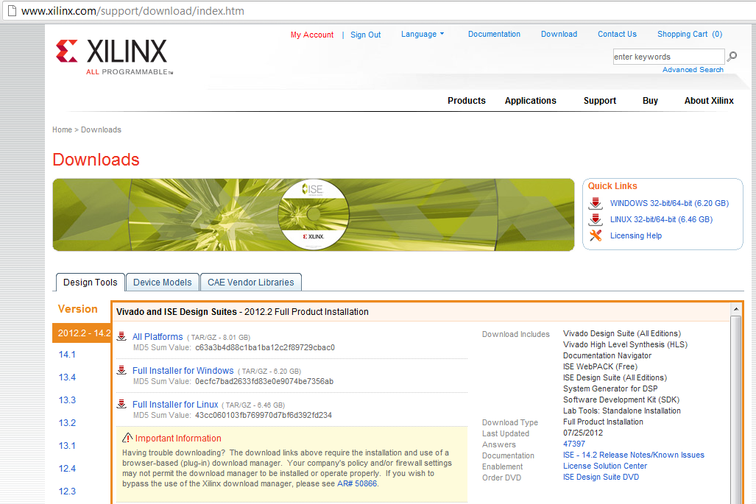
Xilinx ISE
http://www.xilinx.com/support/download/index.htm

Slide 3
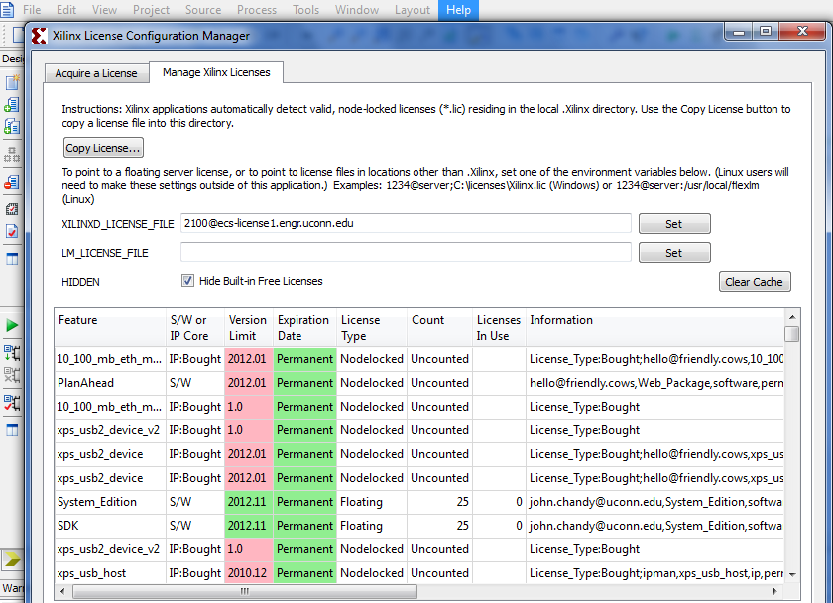
License
2100@ecs-license1.engr.uconn.edu

Slide 4
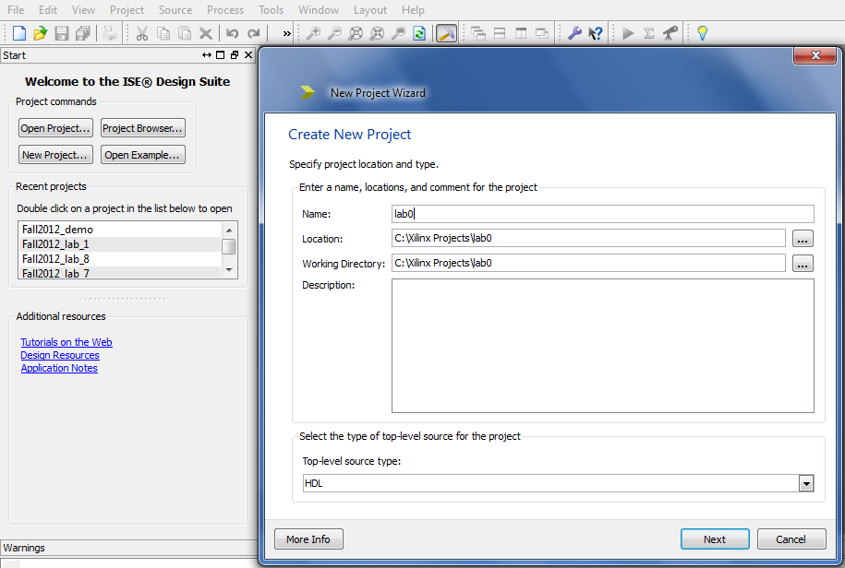
New Project

Slide 5
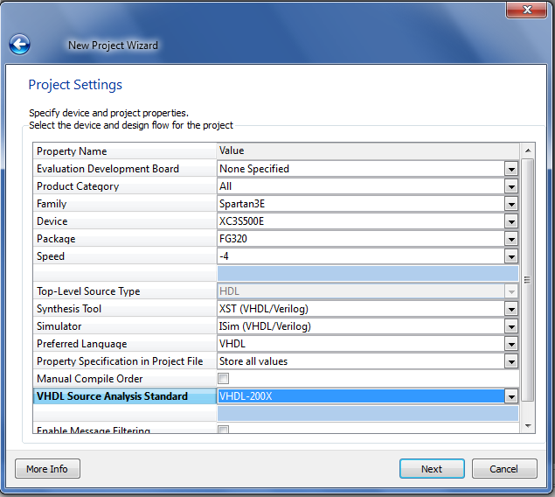
Project Settings

Slide 6
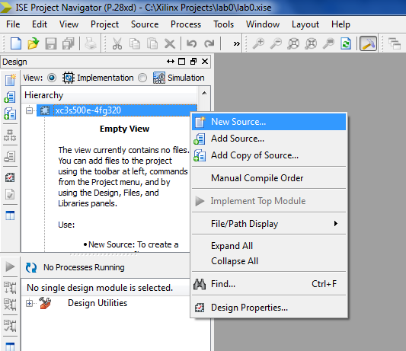
Adding New Source File

Slide 7
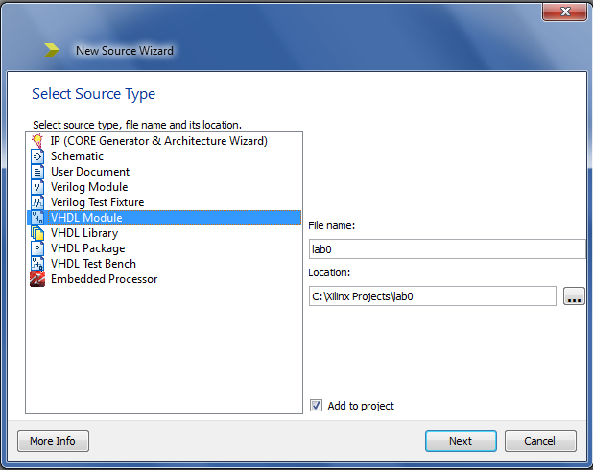
New Source Wizard

Slide 8
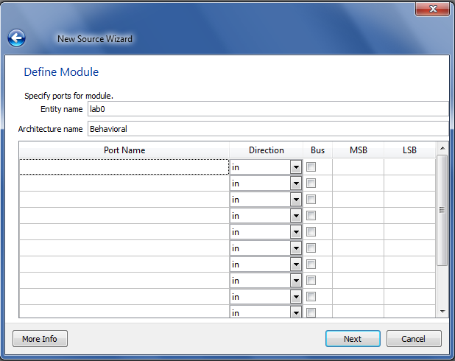
Port List
Skip this, we can add ports later on

Slide 9
Add demo.vhd

Slide 10
Add new source files

Slide 11
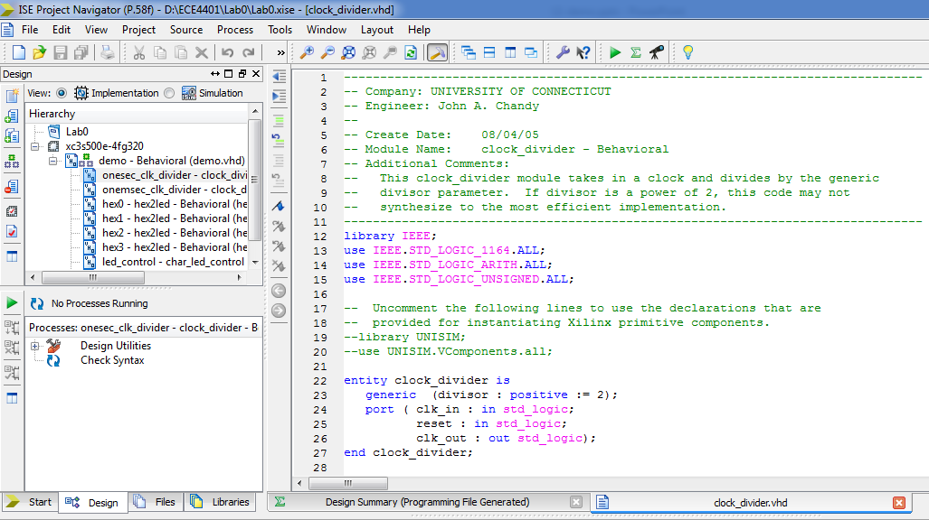
Start Coding

Slide 12
Lab1 files
Code you will write:
clock_divider.vhd
hex2led.vhd
char_led_control.vhd

Slide 13
Add .ucf file
Add copy of source

Slide 14
Setting options
First we need to set some options correctly, right click on “Implement Design” in the Process View and selecting “Process Properties”. In the window that pops up select the checkbox for “Allow Unmatched LOC Constraints” and click “OK”. Then, right click on “Generate Programming File” and select “Process Properties” …. In the window that pops up, click on “Startup Options” and change the “Startup clock” to “JTAG clock”.
Now, you can go ahead and double-click on “Generate Programming File” process.

Slide 15
Impact Steps
Right click on the window
Click on initialize chain in the options
Then click yes, and select the bit file
Then click no for PROMs
Then cancel the next window
Then click apply and ok
Then right click on the green device and click program

